Slide 1
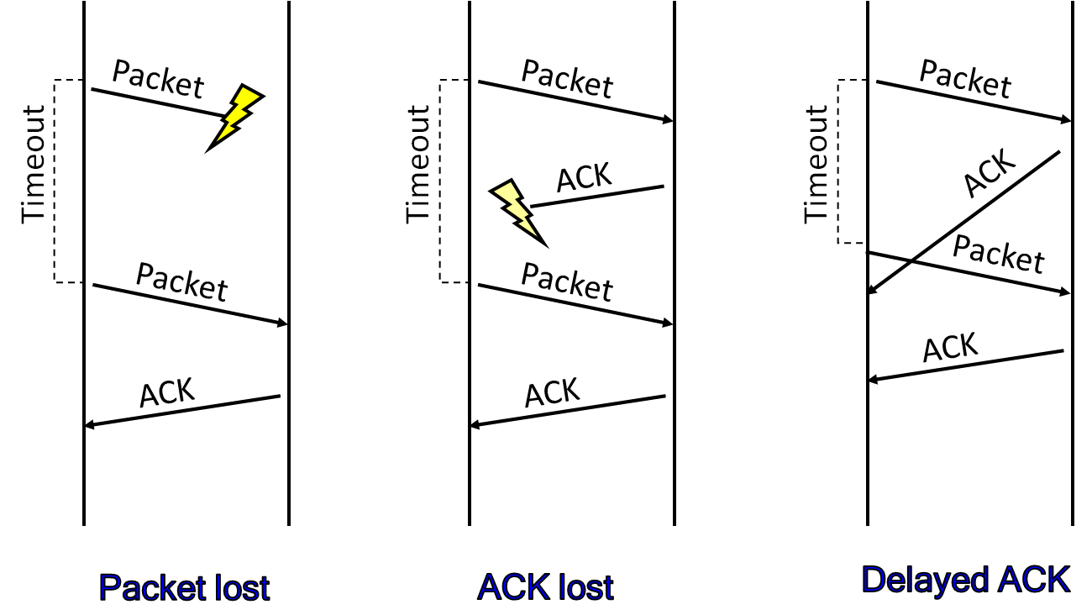
TCP (part 2)
TCP Reliability
Protocols that maintain reliability during a TCP communication session
Notes:
Image Credit: Behroze Forouzan; Notes Credit: Peterson and Davie
The previous three topics covered in the lectures have described various technologies that can be used to connect together a collection of computers: direct links (including LAN technologies like Ethernet and token ring), packet-switched networks (including cell-based networks like ATM), and internetworks. The next problem is to turn this host-to-host packet delivery service into a process-to-process communication channel.
This is the role played by the transport level of the network architecture, which, because it supports
communication between the end application programs, is sometimes called the end-to-end protocol.
The end-to-end protocols will be next topic we’d cover in our Computer Networks Class.

Slide 2
Reliability techniques
Automatic Repeat Request (ARQ) – Error Control
Stop and wait
Sliding windows
Forward Error Correction (FEC)
Selective Repeat
Go back N
Notes:
Detecting errors is only one part of the problem. The other part is correcting errors once detected. There are two basic approaches that can be taken when the recipient of a message detects an error. One is to notify the sender that the message was corrupted so that the sender can retransmit a copy of the message (called Automatic Repeat Request Protocols). If bit errors are rare, then in all probability the retransmitted copy will be error-free. Alternatively, there are some types of error detection algorithms that allow the recipient to reconstruct the correct message even after it has been corrupted; such algorithms are called Forward Error Correction protocols.
While some error codes are strong enough also to correct errors, in practice the overhead is typically too large to handle the range of bit and burst errors that can be introduced on a network link. Even when error-correcting codes are used (e.g., on wireless links), some errors will be too severe to be corrected. As a result, some corrupt frames must be discarded. A link-level protocol that wants to deliver frames reliably must somehow recover from these discarded (lost) frames. This is usually accomplished using a combination of two fundamental mechanisms—acknowledgments and timeouts. An acknowledgment (ACK for short) is a small control frame that a protocol sends back to its peer saying that it has received an earlier frame. By control frame we mean a header without any data, although a protocol can piggyback an ACK on a data frame it just happens to be sending in the opposite direction. The receipt of an acknowledgment indicates to the sender of the original frame that its frame was successfully delivered. If the sender does not receive an acknowledgment after a reasonable amount of time, then it retransmits the original frame. This action of waiting a reasonable amount of time is called a timeout.
The general strategy of using acknowledgments and timeouts to implement reliable delivery is sometimes called automatic repeat request (normally abbreviated ARQ). This section describes three different ARQ algorithms using generic language; that is, we do not give detailed information about a particular protocol’s header fields.

Slide 3
Data-transfer overview
How does the ‘sender’ decide what amount of data to transmit?
application layer
application layer
process
A
process
B
write
read
transport layer
transport layer
buffer for outgoing data
buffer for incoming data
…
port P
…
…
port Q
…
T C P
T C P
to the IP layer
data link
from the IP layer
Source: http://www.cs.usfca.edu/~cruse

Slide 4
Recall the TCP Header
32-bits
source port address
destination port address
sequence number
acknowledgment number
Header
Length
reserved
U
R
G
A
C
K
P
S
H
R
S
T
S
Y
N
F
I
N
window size
checksum
urgent pointer
options and padding …
window
scale
option
‘Sender’ saw this information during initial 3-way handshake
Source: http://www.cs.usfca.edu/~cruse

Slide 5
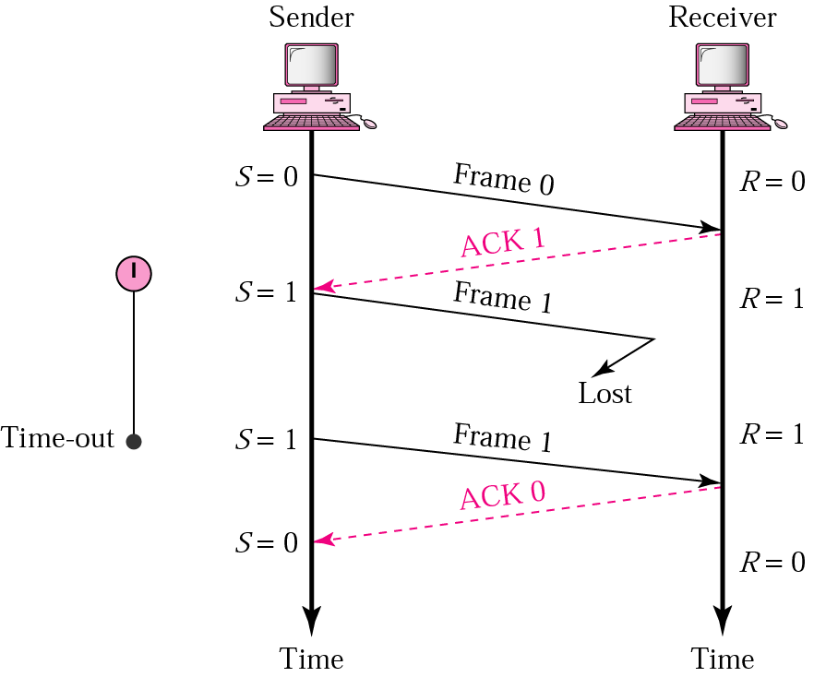
Stop and Wait Protocol
Can you think of any disadvantages
in this protocol?
STEPS
The sender transmits a frame and sets a timer
If the ACK is received before the timer times out, next frame is transmitted
If the ACK is not received before the timer times out, frame is transmitted again and a new timer is set
A new frame is not transmitted until the ACK for the previous one arrives
Notes:
The simplest ARQ scheme is the stop-and-wait algorithm. The idea of stop-and-wait is straightforward: After transmitting one frame, the sender waits for an acknowledgment before transmitting the next frame. If the acknowledgment does not arrive after a certain period of time, the sender times out and retransmits the original frame.
This slide and the next three slides illustrate four different scenarios that result from this basic algorithm (normal operation, lost packet, lost ACK, delayed ACK). Recall that by “lost” we mean that the frame was corrupted while in transit, that this corruption was detected by an error code on the receiver, and that the frame was subsequently discarded.

Slide 6
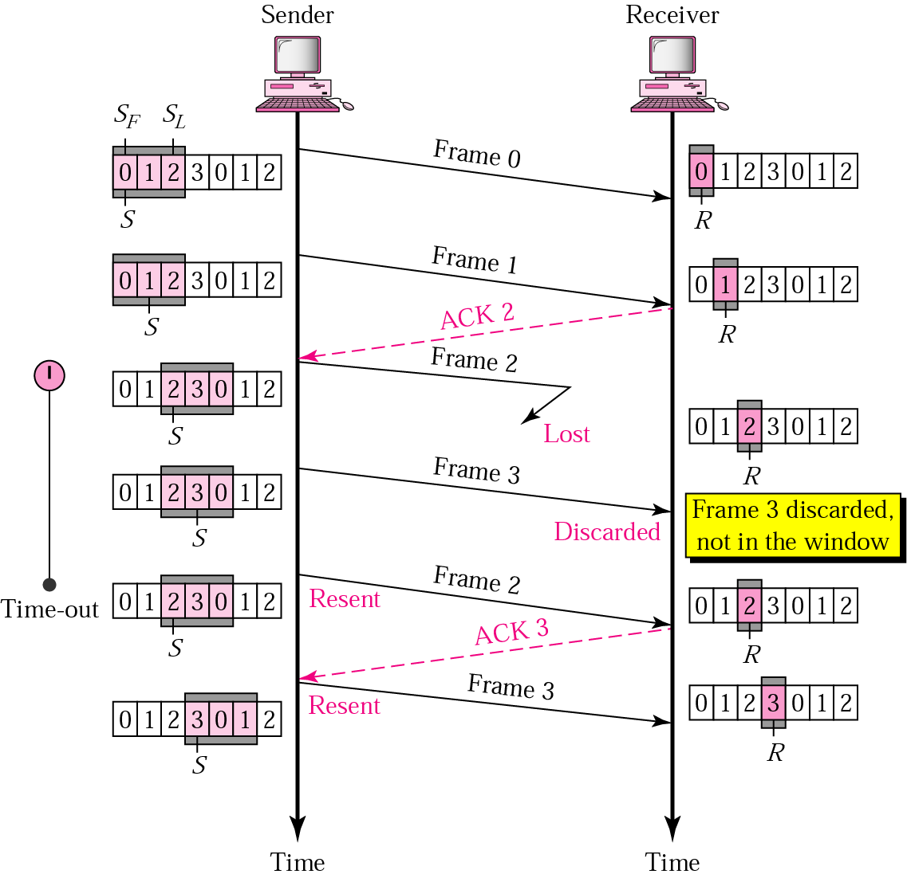
Sliding windows (SW): Go-back-N
Window size defines how many
unacknowledged packets can the
sender send before it stops to
send any more, and waits for ACK
More packets may only be sent
once the acknowledgement for
the previously sent packets
is received
Just like stop-and-wait, multiple
packets can be acknowledged with
a single acknowledgement having
the number of last received packet
STEPS
Sender window size and receiver window size is set
This window size must be maintained by the sender at all times
If ACK is not received, window does not move ahead
If ACK is received, window moves ahead according to the number of packets acknowledged
Timer is kept for all transmitted packets

Slide 7
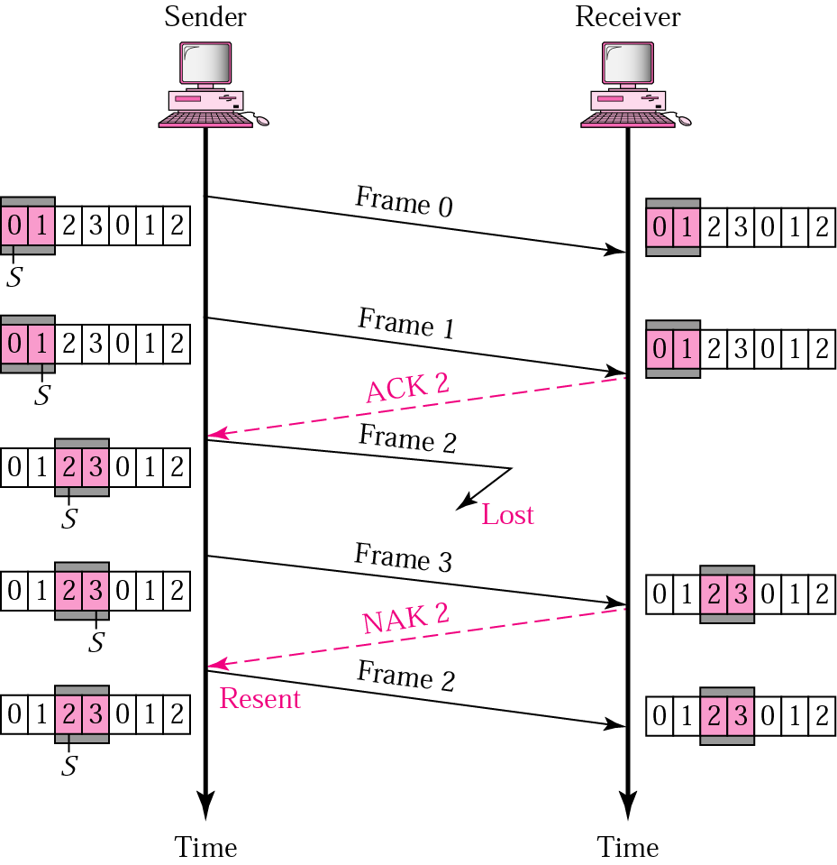
SW: Selective Repeat
The receiver may only be missing a few packets, in which case, by using selective repeat, only the packets that are missing are retransmitted. Unacknowledged packets are also “individually” retransmitted by the sender, after timer times out, unlike in Go-back-n.
When a packet is lost, all packets received until the missing packet arrives are buffered. When the missing packet arrives, buffered and missing packets are passed to the transport layer together.
Advantages?
-Saves bandwidth
-Saves time
STEPS
The sender transmits frames while keeping within the sender window limits, sets timers and waits for ACK
If ACK does not arrive and timer times out, sender re-transmits the packet
Notes:
When used as the protocol for the delivery of messages, the sending process continues to send a number of frames specified by a window size even after a frame loss. Unlike Go-Back-N ARQ, the receiving process will continue to accept and acknowledge frames sent after an initial error.

Slide 8
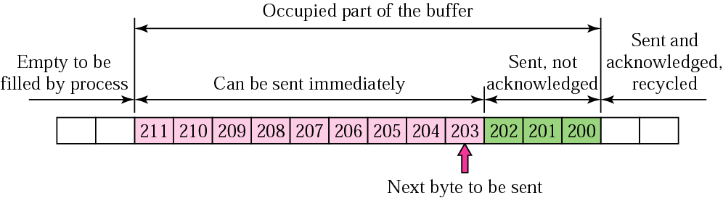
TCP’s sliding windows
Sliding window---sender’s end
Timer should be larger than the “round trip time” RTT
SampleRTT
EstimatedRTT – weighted average of SampleRTT (a better measure!)
EstimatedRTT = (1- α) . EstimatedRTT + α . SampleRTT
(α = 1/8)
When timer times out, TCP retransmits the unacknowledged segment with the smallest sequence number
A new timer is set for every retransmission
Timer value is doubled (from previous value) every time a segment is retransmitted
If timer was set to 0.5 sec, when retransmitted timer will be set to 1 sec

Slide 9
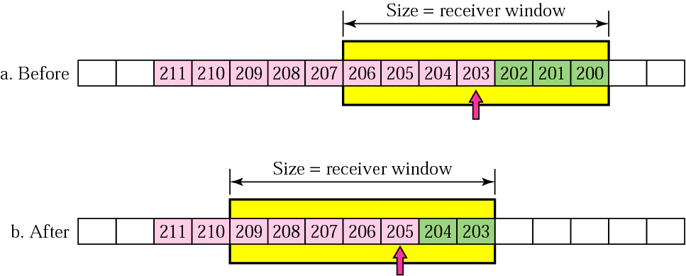
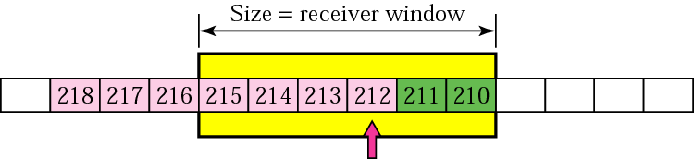
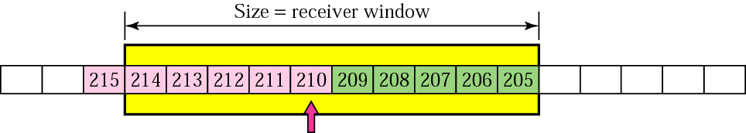
Windows (Sliding/ Expanding/ Shrinking)
Sliding Windows
Expanding/ Shrinking Windows (based on receiver advertised window)

Slide 10
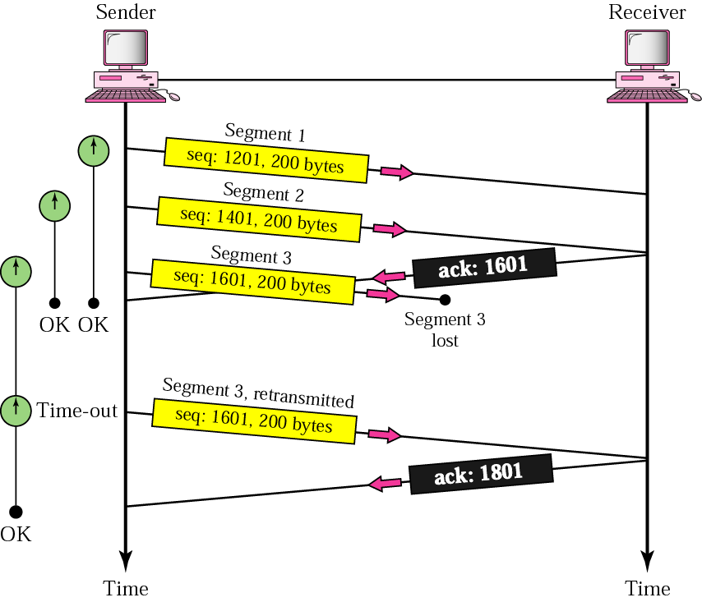
TCP SW: Lost Segment

Slide 11
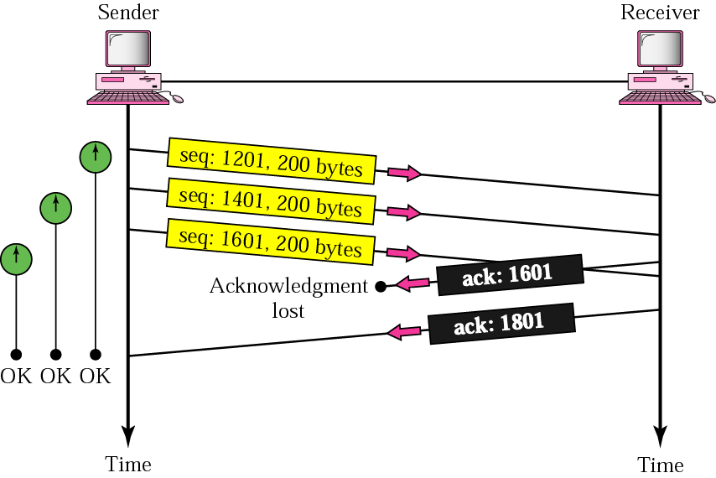
TCP SW: Lost Acknowledgement

Slide 12
Summary
At the heart of TCP is the end-to-end sliding windows :
TCP requires explicit connection establishment/ breakdown
TCP requires adaptive timeout mechanism
TCP must be able to handle packets way out of order
TCP must support parameter negotiation and flow-control
TCP must be able to deal with network congestion
Notes:
At the heart of TCP is the sliding window algorithm. Even though this is the same basic algorithm we saw in Topic 2---Direct link networks, because TCP runs over the Internet rather than a point-to-point link, there are many important differences. We will now identify these differences and explains how they complicate TCP.
First, whereas the sliding window algorithm presented in Topic 2 runs over a single physical link that always connects the same two computers, TCP supports logical connections between processes that are running on any two computers in the Internet. This means that TCP needs an explicit connection establishment phase during which the two sides of the connection agree to exchange data with each other. This difference is analogous to having to dial up the other party, rather than having a dedicated phone line. TCP also has an explicit connection teardown phase. One of the things that happens during connection establishment is that the two parties establish some shared state to enable the sliding window algorithm to begin. Connection teardown is needed so each host knows it is OK to free this state.
(In summary, TCP will require connection establishment and connection termination)
Second, whereas a single physical link that always connects the same two computers has a fixed RTT, TCP connections are likely to have widely different round-trip times. These end-to-end RTTs vary widely on the basis of time of day and load on network. Variations in the RTT are even possible during a single TCP connection that lasts only a few minutes. What this means to the sliding window algorithm is that the timeout mechanism that triggers retransmissions must be adaptive. (Certainly, the timeout for a point-to-point link must be a settable parameter, but it is not necessary to adapt this timer for a particular pair of nodes.)
(In summary, TCP will require adaptive timeout mechanism)
Third, packets may be reordered as they cross the Internet, but this is not possible on a point-to-point link where the first packet put into one end of the link must be the first to appear at the other end. Packets that are slightly out of order do not cause a problem since the sliding window algorithm can reorder packets correctly using the sequence number. The real issue is how far out-of-order packets can get, or said another way, how late a packet can arrive at the destination. In the worst case, a packet can be delayed in the Internet until IP’s time to live (TTL) field expires, at which time the packet is discarded (and hence there is no danger of it arriving late). Knowing that IP throws packets away after their TTL expires, TCP assumes that each packet has a maximum lifetime. The exact lifetime, known as the maximum segment lifetime (MSL), is an engineering choice. The current recommended setting is 120 seconds. Keep in mind that IP does not directly enforce this 120-second value; it is simply a conservative estimate that TCP makes of how long a packet might live in the Internet. The implication is significant—TCP has to be prepared for very old packets to suddenly show up at the receiver, potentially confusing the sliding window algorithm.
(In summary, TCP must be able to handle packets that are way out of order)
Fourth, the computers connected to a point-to-point link are generally engineered to support the link. For example, if a link’s delay × bandwidth product is computed to be 8 KB—meaning that a window size is selected to allow up to 8 KB of data to be unacknowledged at a given time—then it is likely that the computers at either end of the link have the ability to buffer up to 8 KB of data. Designing the system otherwise would be silly. On the other hand, almost any kind of computer can be connected to the Internet, making the amount of resources dedicated to any one TCP connection highly variable, especially considering that any one host can potentially support hundreds of TCP connections at the same time. This means that TCP must include a mechanism that each side uses to “learn” what resources (e.g., how much buffer space) the other side is able to apply to the connection. This is the flow-control issue.
(In summary, the communicating entities must have ability to negotiate parameters and be able to perform flow-control)
Fifth, because the transmitting side of a directly connected link cannot send any faster than the bandwidth of the link allows, and only one host is pumping data into the link, it is not possible to unknowingly congest the link. Said another way, the load on the link is visible in the form of a queue of packets at the sender. In contrast, the sending side of a TCP connection has no idea what links will be traversed to reach the destination. For example, the sending machine might be directly connected to a relatively fast Ethernet—and so, capable of sending data at a rate of 100 Mbps—but somewhere out in the middle of the network, a 1.5-Mbps T1 link must be traversed. And to make matters worse, data being generated by many different sources might be trying to traverse this same slow link. This leads to the problem of network congestion.
(In summary, TCP must be able to deal with network congestion)

Slide 13
Online Demo
Use the following link to see an interactive online demo
for TCP windows
http://www2.rad.com/networks/2004/sliding_window/demo.html

Slide 14
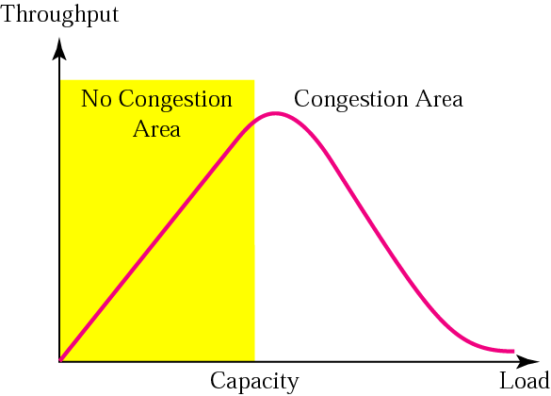
TCP (part 3)
TCP Congestion Control
Lecture Slides Courtesy: Dr Junaid Qadir
Notes:
Credit: Forouzan
http://www2.ic.uff.br/~michael/kr1999/3-transport/3_07-congestion.html

Slide 15
Topic’s objectives
To learn about:
Flow Control vs. Congestion Control
TCP’s Congestion Control
Slow Start
AIMD Congestion Avoidance
Fast Recovery and Fast Retransmit
TCP Implementations (Tahoe, Reno)

Slide 16
Flow Control vs.
Congestion Control
1

Slide 17
Networks in late 1986
5,089 hosts on Internet
Backbone speed: 50 – 56 kbps
Control mechanism focused on receiver congestion and not on network congestion
TCP flow control only prevented overwhelming receivers; did not focus on network congestion

Slide 18
Congestion Collapse
Oct 1986, Internet had its first congestion collapse
Link LBL to UC Berkeley
400 yards, 3 hops, 32 Kbps
throughput dropped to 40 bps
factor of ~1000 drop!
Van Jacobson proposed TCP congestion control (1988)
Throughput
Load
Notes:
LBL = Lawrence Berkeley Laboratory (LBL)

Slide 19
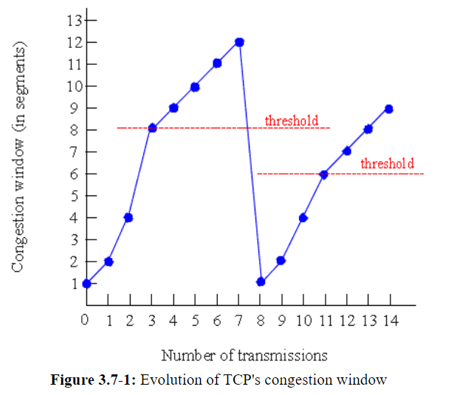

Slide 20
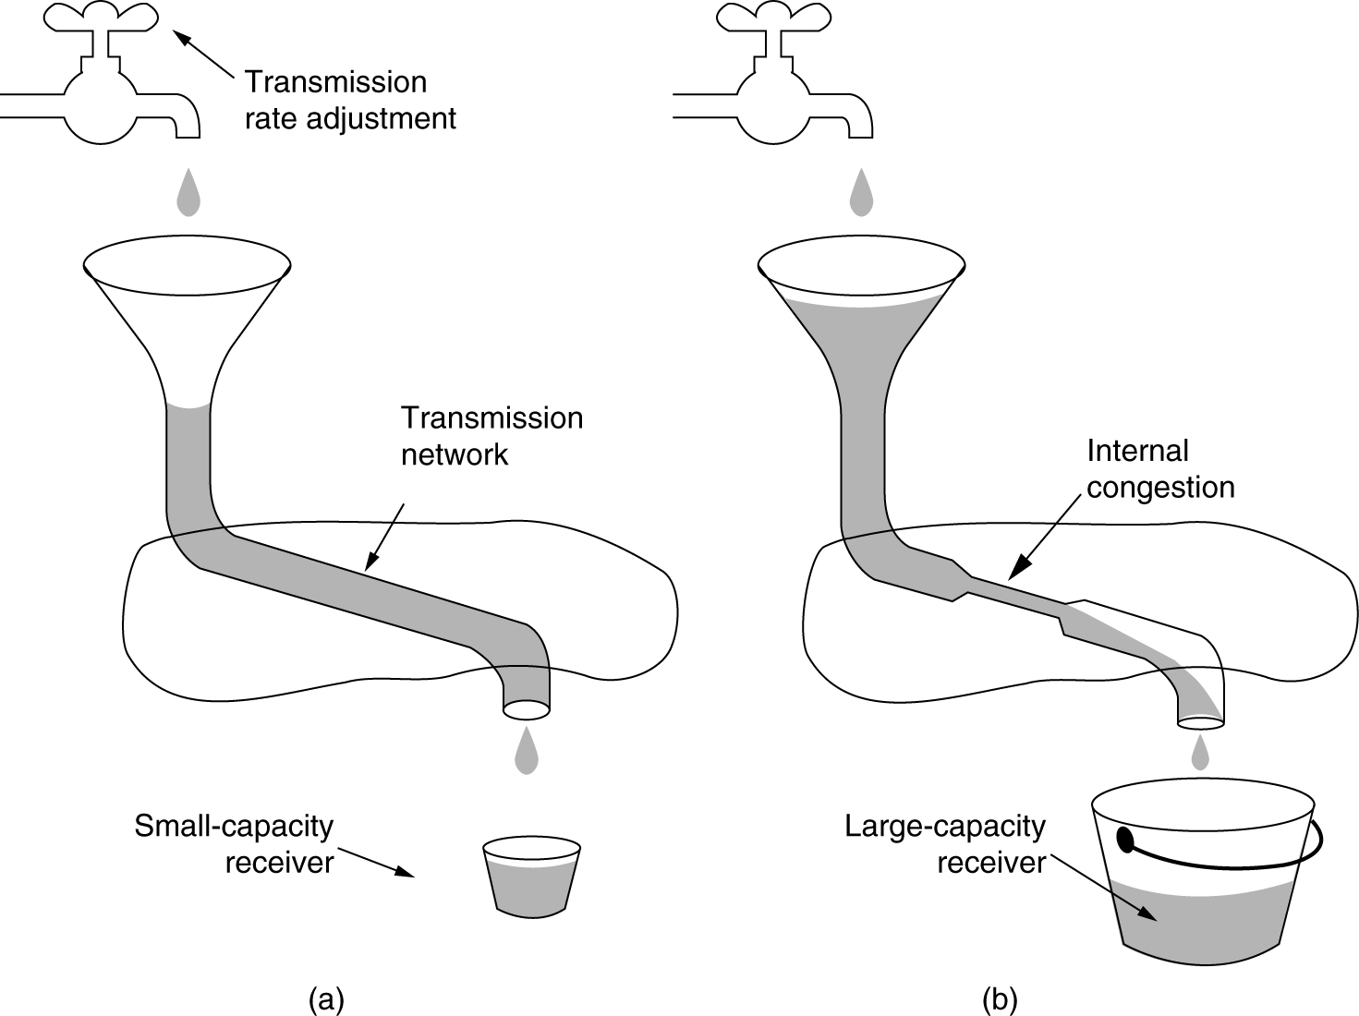
Flow vs Congestion Control
Flow Control
Congestion Control
Notes:
Credit: Forouzan

Slide 21
2
TCP’s Congestion Control
AIMD Congestion Avoidance
Slow Start
Fast Recovery and Fast Retransmit
Notes:
This section describes the predominant example of end-to-end congestion control in use today, that implemented by TCP. The essential strategy of TCP is to send packets into the network without a reservation and then to react to observable events that occur. TCP assumes only FIFO queuing in the network’s routers, but also works with fair queuing.
TCP congestion control was introduced into the Internet in the late 1980s by Van Jacobson, roughly eight years after the TCP/IP protocol stack had become operational. Immediately preceding this time, the Internet was suffering from congestion collapse— hosts would send their packets into the Internet as fast as the advertised window would allow, congestion would occur at some router (causing packets to be dropped), and the hosts would time out and retransmit their packets, resulting in even more congestion. Broadly speaking, the idea of TCP congestion control is for each source to determine how much capacity is available in the network, so that it knows how many packets it can safely have in transit. Once a given source has this many packets in transit, it uses the arrival of an ACK as a signal that one of its packets has left the network, and that it is therefore safe to insert a new packet into the network without adding to the level of congestion. By using ACKs to pace the transmission of packets, TCP is said to be self-clocking. Of course, determining the available capacity in the first place is no easy task. To make matters worse, because other connections come and go, the available bandwidth changes over time, meaning that any given source must be able to adjust the number of packets it has in transit.
We will now describe algorithms used by TCP to address these and other problems. Note that although we describe these mechanisms one at a time, thereby giving the impression that we are talking about three independent mechanisms, it is only when they are taken as a whole that we have TCP congestion control.

Slide 22
Cost of congestion?
Routers with infinite buffers do not exist
Large queuing delays occur as packet arrival rate nears the link capacity
The sender must perform re-transmissions for dropped packets due to buffer overflow
Unneeded re-transmissions due to large delays reduces effective bandwidth of the network
From the time a packet is dropped, all previous effort to transmit that packet is wasted – BW wasted

Slide 23
How can we avoid congestion?
Early on, hosts would send their packets into the Internet as fast as the advertised window would allow, congestion would occur at some router (causing packets to be dropped), and the hosts would time out and retransmit their packets, resulting in even more congestion
TCP Basic idea:
- If there is no ACK, there must be congestion
- If everything is going fine, there must be more room

Slide 24
Congestion Window?
How TCP comes to learn an appropriate value for CongestionWindow.
Unlike the AdvertisedWindow, which is sent by the receiving side of the connection, there is no one to send a suitable CongestionWindow to the sending side of TCP. The answer is that the TCP source sets the Congestion Window based on the level of congestion it perceives to exist in the network.
This involves decreasing the congestion window when the level of congestion goes up and increasing the congestion window when the level of congestion goes down. Taken together, the mechanism is commonly called additive increase/multiplicative decrease (AIMD).

Slide 25
Congestion Window?
TCP interprets timeouts as a sign of congestion and reduces the rate at which it is transmitting.
Specifically, each time a timeout occurs, the source sets Congestion Window to half of its previous value. This halving of the Congestion Window for each timeout corresponds to the “multiplicative decrease” part of AIMD.

Slide 26
Congestion Window?
Congestion window size is increased exponentially with every successful packet transmission until a threshold is reached
Threshold=congestion window size / 2
After the threshold, the window is increased linearly with every successful packet
Congestion Window is not allowed to fall below the size of a single packet, or in TCP terminology, the maximum segment size (MSS).

Slide 27
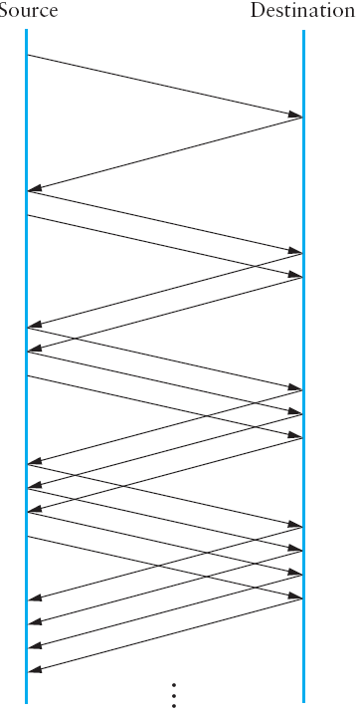
a) AIMD Congestion Avoidance
Additive Increase: Congestion Window increments every RTT
Source
Destination
Additive Increase
STEPS
Send all CongestionWindow
RCV all ACKs within one RTT
CongestionWindow++
Repeat…
Notes:
A congestion-control strategy that only decreases the window size is obviously too conservative. We also need to be able to increase the congestion window to take advantage of newly available capacity in the network. This is the “additive increase”. part of AIMD, and it works as follows. Every time the source successfully sends a CongestionWindow’s worth of packets—that is, each packet sent out during the last RTT has been ACKed—it adds the equivalent of one packet to CongestionWindow. This linear increase is illustrated in the figure above.

Slide 28
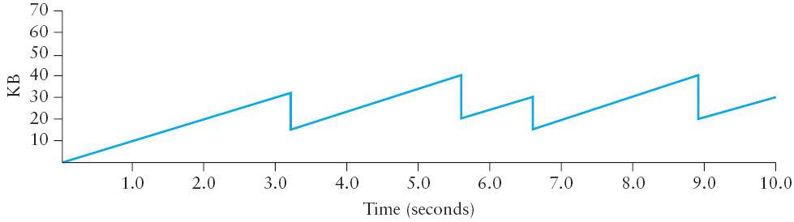
AIMD Congestion Avoidance
Multiplicative Decrease: Congestion Window halves on Packet loss
Multiplicative Decrease
State maintained by TCP for each connection – CongestionWindow
Amount of unacknowledged data must not exceed min(CongWin, RcvWindow)
Multiplicative decrease results in saw-tooth like congestion window profile
Each time congestion occurs, window is reduced to half the current size
Notes:
TCP maintains a new state variable for each connection, called CongestionWindow, which is used by the source to limit how much data it is allowed to have in transit at a given time. The congestion window is congestion control’s counterpart to flow control’s advertised window. TCP is modified such that the maximum number of bytes of unacknowledged data allowed is now the minimum of the congestion window and the advertised window.
Thus, a TCP source is allowed to send no faster than the slowest component—the network or the destination host—can accommodate. The network limit is estimated using the CongestionWindow parameter whereas the receiver limit is advertised using the AdvertisedWindow paramater.
Problem: The problem, of course, is how TCP comes to learn an appropriate value for CongestionWindow. Unlike the AdvertisedWindow, which is sent by the receiving side of the connection, there is no one to send a suitable CongestionWindow to the sending side of TCP. The answer is that the TCP source sets the CongestionWindow based on the level of congestion it perceives to exist in the network. This involves decreasing the congestion window when the level of congestion goes up and increasing the congestion window when the level of congestion goes down. Taken together, the mechanism is commonly called additive increase/multiplicative decrease (AIMD).
The key question, then, is how does the source determine that the network is congested and that it should decrease the congestion window? The answer is based on the observation that the main reason packets are not delivered, and a timeout results, is that a packet was dropped due to congestion. It is rare that a packet is dropped because of an error during transmission. Therefore, TCP interprets timeouts as a sign of congestion and reduces the rate at which it is transmitting. Specifically, each time a timeout occurs, the source sets CongestionWindow to half of its previous value. This halving of the CongestionWindow for each timeout corresponds to the “multiplicative decrease” part of AIMD.
(Although CongestionWindow is defined in terms of bytes, it is easiest to understand multiplicative decrease if we think in terms of whole packets. For example, suppose the CongestionWindow is currently set to 16 packets. If a loss is detected, CongestionWindow is set to 8. Normally, a loss is detected when a timeout occurs, but as we see below, TCP has another mechanism to detect dropped packets. Additional losses cause CongestionWindow to be reduced to 4, then 2, and finally to 1 packet. CongestionWindow is not allowed to fall below the size of a single packet, or in TCP terminology, the maximum segment size (MSS).)

Slide 29
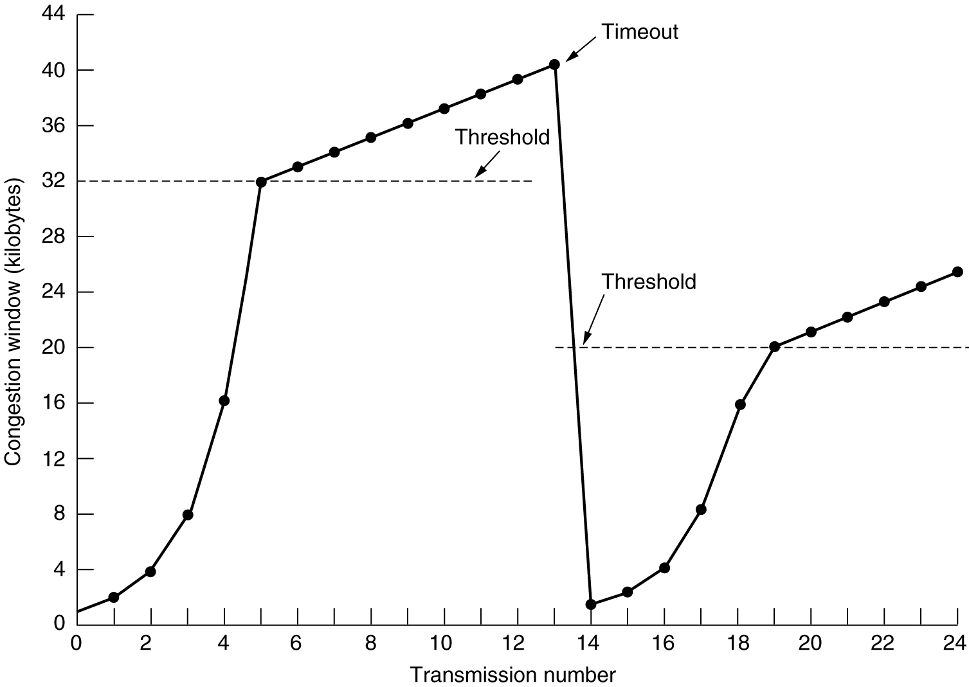
Congestion-Avoidance (AIMD) Example
Increase additively after the SSThreshold (Additive Increase – increase by 1 MSS every RTT [RFC 2581] if all ACKs rcvd)
What will happen when the CongestionWindow reaches the network’s bottleneck capacity?
Notes:
The figure above traces how TCP’s Congestion Window increases and decreases over time and serves to illustrate the interplay of slow start and additive increase/ multiplicative decrease. This trace was taken from an actual TCP connection and shows the current value of CongestionWindow—the colored line—over time.
There are several things to notice about this trace. The first is the rapid increase in the congestion window at the beginning of the connection. This corresponds to the initial slow start phase. The slow start phase continues until several packets are lost at about 0.4 seconds into the connection, at which time Congestion Window flattens out at about 32 KB.
The reason the congestion window flattens is that there are no ACKs arriving, due to the fact that several packets were lost. In fact, no new packets are sent during this time, as denoted by the lack of hash marks at the top of the graph. A timeout eventually happens at approximately 13 seconds, at which time the congestion window is divided by 2 (i.e., cut from approximately 40 KB to around 20 KB) and Congestion Threshold is set to this value. Slow start then causes Congestion Window to be reset to one packet and to start ramping up from there.
At about 4 seconds, Congestion Window flattens out, again due to a lost packet.

Slide 30
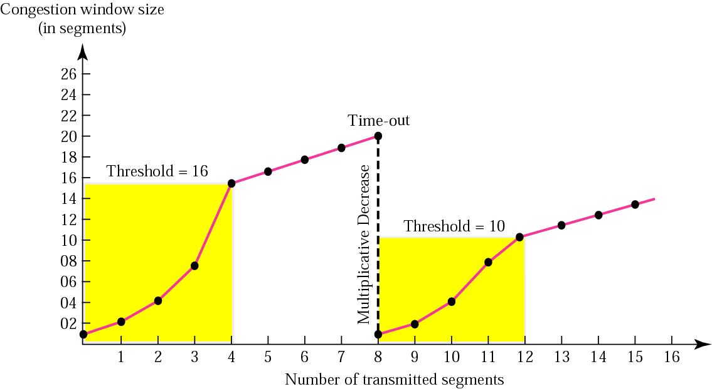
Congestion-Avoidance (AI) Example
RTTs
Increase additively after the SSThreshold (Additive Increase – increase by 1 MSS every RTT [RFC 2581] if all ACKs rcvd)
What will happen when the CongestionWindow reaches the network’s bottleneck capacity?
Notes:
The figure above traces how TCP’s Congestion Window increases and decreases over time and serves to illustrate the interplay of slow start and additive increase/ multiplicative decrease. This trace was taken from an actual TCP connection and shows the current value of CongestionWindow—the colored line—over time.
There are several things to notice about this trace. The first is the rapid increase in the congestion window at the beginning of the connection. This corresponds to the initial slow start phase. The slow start phase continues until several packets are lost at about 0.4 seconds into the connection, at which time Congestion Window flattens out at about 32 KB.
The reason the congestion window flattens is that there are no ACKs arriving, due to the fact that several packets were lost. In fact, no new packets are sent during this time, as denoted by the lack of hash marks at the top of the graph. A timeout eventually happens at approximately 13 seconds, at which time the congestion window is divided by 2 (i.e., cut from approximately 40 KB to around 20 KB) and Congestion Threshold is set to this value. Slow start then causes Congestion Window to be reset to one packet and to start ramping up from there.
At about 4 seconds, Congestion Window flattens out, again due to a lost packet.

Slide 31
Congestion-Avoidance (MD) Example
Multiplicatively decrease and readjust SSThreshold
RTTs
TCP is attempting to learn how much bandwidth is available on the network.
Notes:
Now, at about 8 seconds:
A timeout happens, causing the congestion window to be divided by 2, dropping it from approximately 20 KB to 10 KB, and CongestionThreshold is set to this amount.
CongestionWindow is reset to one packet, as the sender enters slow start.
Slow start causes CongestionWindow to grow exponentially until it reaches CongestionThreshold.
4) CongestionWindow then grows linearly.
The same pattern is repeated at around 8 seconds when another timeout occurs.
We now return to the question of why so many packets are lost during the initial slow start period. At this point, TCP is attempting to learn how much bandwidth is available on the network. This is a very difficult task. If the source is not aggressive at this stage—for example, if it only increases the congestion window linearly—then it takes a long time for it to discover how much bandwidth is available. This can have a dramatic impact on the throughput achieved for this connection. On the other hand, if the source is aggressive at this stage, as TCP is during exponential growth, then the source runs the risk of having half a window’s worth of packets dropped by the network.
To see what can happen during exponential growth, consider the situation in which the source was just able to successfully send 16 packets through the network, causing it to double its congestion window to 32. Suppose, however, that the network happens to have just enough capacity to support 16 packets from this source. The likely result is that 16 of the 32 packets sent under the new congestion window will be dropped by the network; actually, this is the worst-case outcome, since some of the packets will be buffered in some router.

Slide 32
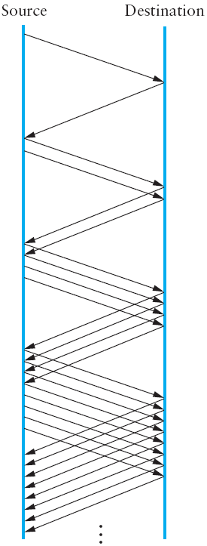
b) Slow Start
Source
Destination
Increases congestion window rapidly from a cold start.
Better than sending the entire window worth of data at once.
Reduces congestion at the intermediate routers.
STEPS
Send one packet
Receive ACK
Send two now (ACK * 2)
RCV two ACKS
Send four now (ACK * 2)
RCV four ACKS
Send eight now (ACK * 2)
Why is this called slow start? Slow compared to?
Notes:
The additive increase mechanism just described is the right approach to use when the source is operating close to the available capacity of the network, but it takes too long to ramp up a connection when it is starting from scratch. TCP therefore provides a second mechanism, ironically called slow start, that is used to increase the congestion window rapidly from a cold start. Slow start effectively increases the congestion window exponentially, rather than linearly.
Why any exponential mechanism would be called “slow” is puzzling at first, but it can be explained if put in the proper historical context. We need to compare slow start not against the linear mechanism of the previous subsection, but against the original behavior of TCP. Consider what happens when a connection is established and the source first starts to send packets, that is, when it currently has no packets in transit. If the source sends as many packets as the advertised window allows—which is exactly what TCP did before slow start was developed—then even if there is a fairly large amount of bandwidth available in the network, the routers may not be able to consume this burst of packets. It all depends on how much buffer space is available at the routers. Slow start was therefore designed to space packets out so that this burst does not occur. In other words, even though its exponential growth is faster than linear growth, slow start is much “slower” than sending an entire advertised window’s worth of data all at once.
Specifically, the source starts out by setting CongestionWindow to one packet. When the ACK for this packet arrives, TCP adds 1 to CongestionWindow and then sends two packets. Upon receiving the corresponding two ACKs, TCP increments CongestionWindow by 2—one for each ACK—and next sends four packets. The end result is that TCP effectively doubles the number of packets it has in transit every RTT. The figure above shows the growth in the number of packets in transit during slow start. Compare this to the linear growth of additive increase shown in the previous slide.

Slide 33
Slow Start Example
STEPS
Slow start phase: Exponential increase in congestion window
Continues until Threshold
Exponential increase stops
Additive increase starts with every subsequent RTT
(detail later in lecture)
Increase exponentially only till
Slow-Start Threshold (SSthreshold)
Typically 65 KBytes
RTTs
We can’t keep on increasing the congestion window exponentially!

Slide 34
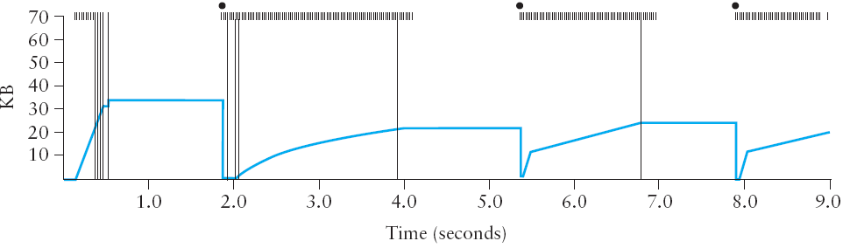
Slow Start and Congestion-Avoidance
Pkts lost
time out
no ACKs no new Tx
new
SSthreshold
1 MSS
Linear inc.
This trace was taken from an actual TCP connection and shows the current value of CongestionWindow – blue line.
Notes:
The figure above traces how TCP’s CongestionWindow increases and decreases over time and serves to illustrate the interplay of slow start and additive increase/ multiplicative decrease. This trace was taken from an actual TCP connection and shows the current value of CongestionWindow—the colored line—over time.
There are several things to notice about this trace. The first is the rapid increase in the congestion window at the beginning of the connection. This corresponds to the initial slow start phase. The slow start phase continues until several packets are lost at about 0.4 seconds into the connection, at which time CongestionWindow flattens out at about 34 KB.
The reason the congestion window flattens is that there are no ACKs arriving, due to the fact that several packets were lost. In fact, no new packets are sent during this time, as denoted by the lack of hash marks at the top of the graph. A timeout eventually happens at approximately 2 seconds, at which time the congestion window is divided by 2 (i.e., cut from approximately 34 KB to around 17 KB) and CongestionThreshold (or SSThreshold) is set to this value. Slow start then causes CongestionWindow to be reset to one packet and to start ramping up from there.
There is not enough detail in the trace to see exactly what happens when a couple of packets are lost just after 2 seconds, so we jump ahead to the linear increase in the congestion window that occurs between 2 and 4 seconds. This corresponds to additive increase. At about 4 seconds, CongestionWindow flattens out, again due to a lost packet.
Now, at about 5.5 seconds:
A timeout happens, causing the congestion window to be divided by 2, dropping it from approximately 22 KB to 11 KB, and CongestionThreshold is set to this amount.
CongestionWindow is reset to one packet, as the sender enters slow start.
Slow start causes CongestionWindow to grow exponentially until it reaches CongestionThreshold.
4) CongestionWindow then grows linearly.
The same pattern is repeated at around 8 seconds when another timeout occurs.
We now return to the question of why so many packets are lost during the initial slow start period. At this point, TCP is attempting to learn how much bandwidth is available on the network. This is a very difficult task. If the source is not aggressive at this stage—for example, if it only increases the congestion window linearly—then it takes a long time for it to discover how much bandwidth is available. This can have a dramatic impact on the throughput achieved for this connection. On the other hand, if the source is aggressive at this stage, as TCP is during exponential growth, then the source runs the risk of having half a window’s worth of packets dropped by the network. [See time=2s]
To see what can happen during exponential growth, consider the situation in which the source was just able to successfully send 16 packets through the network, causing it to double its congestion window to 32. Suppose, however, that the network happens to have just enough capacity to support 16 packets from this source. The likely result is that 16 of the 32 packets sent under the new congestion window will be dropped by the network; actually, this is the worst-case outcome, since some of the packets will be buffered in some router.

Slide 35
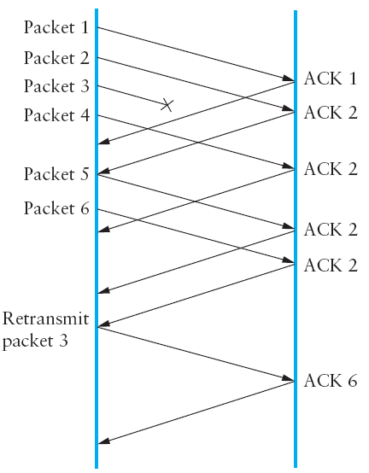
c) Fast Retransmit
Retransmit packets without waiting for timer time-out
Duplicate ACKs used to trigger re-transmission
Duplicate ACKs are a sign that the original packet has been lost
Long wait times, waiting for timers to expire caused connection to become dead.
Fast-retransmit was added to TCP as a result.
STEPS
Send packets
Wait for ACK
At Destination
If packet lost (no ACK)
Previous ACK re-sent
Duplicate ACKs?
Receive 3 duplicate ACKs
Re-transmit packet
Receive pending ACKs
Source
Destination
Notes:
The mechanisms described so far were part of the original proposal to add congestion control to TCP. It was soon discovered, however, that the coarse-grained implementation of TCP timeouts led to long periods of time during which the connection went dead while waiting for a timer to expire. Because of this, a new mechanism called fast re-transmit was added to TCP. Fast retransmit is a heuristic that sometimes triggers the retransmission of a dropped packet sooner than the regular timeout mechanism. The fast retransmit mechanism does not replace regular timeouts; it just enhances that facility.
The idea of fast retransmit is straightforward. Every time a data packet arrives at the receiving side, the receiver responds with an acknowledgment, even if this sequence number has already been acknowledged. Thus, when a packet arrives out of order— that is, TCP cannot yet acknowledge the data the packet contains because earlier data has not yet arrived—TCP resends the same acknowledgment it sent the last time. This second transmission of the same acknowledgment is called a duplicate ACK.
When the sending side sees a duplicate ACK, it knows that the other side must have received a packet out of order, which suggests that an earlier packet might have been lost. Since it is also possible that the earlier packet has only been delayed rather than lost, the sender waits until it sees some number of duplicate ACKs and then retransmits the missing packet. In practice, TCP waits until it has seen three duplicate ACKs before retransmitting the packet.
The figure above illustrates how duplicate ACKs lead to a fast retransmit. In this example, the destination receives packets 1 and 2, but packet 3 is lost in the network. Thus, the destination will send a duplicate ACK for packet 2 when packet 4 arrives, again when packet 5 arrives, and so on. (To simplify this example, we think in terms of packets 1, 2, 3, and so on, rather than worrying about the sequence numbers for each byte.) When the sender sees the third duplicate ACK for packet 2—the one sent because the receiver had gotten packet 6—it retransmits packet 3. Note that when the retransmitted copy of packet 3 arrives at the destination, the receiver then sends a cumulative ACK for everything up to and including packet 6 back to the source.

Slide 36
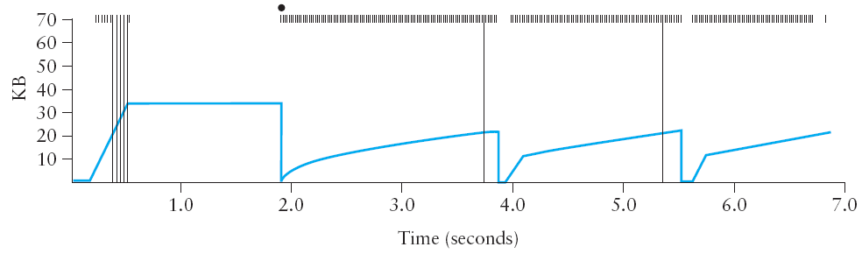
Fast Retransmit
Without Fast Retransmit
With Fast Retransmit
Notes:
The figure above illustrates the behavior of a version of TCP with the fast retransmit mechanism. It is interesting to compare this trace with that given in the previous figure, where fast retransmit was not implemented—the long periods during which the congestion window stays flat and no packets are sent have been eliminated. In general, this technique is able to eliminate about half of the coarse-grained timeouts on a typical TCP connection, resulting in roughly a 20% improvement in the throughput over what could otherwise have been achieved. Notice, however, that the fast retransmit strategy does not eliminate all coarse-grained timeouts. This is because for a small window size, there will not be enough packets in transit to cause enough duplicate ACKs to be delivered.
Given enough lost packets—for example, as happens during the initial slow start phase—the sliding window algorithm eventually blocks the sender until a timeout occurs. Given the current 64-KB maximum advertised window size, TCP’s fast retransmit mechanism is able to detect up to three dropped packets per window in practice.
Finally, there is one last improvement we can make. When the fast retransmit mechanism signals congestion, rather than drop the congestion window all the way back to one packet and run slow start, it is possible to use the ACKs that are still in the pipe to clock the sending of packets. This mechanism, which is called fast recovery, effectively removes the slow start phase that happens between when fast retransmit detects a lost packet and additive increase begins. For example, fast recovery avoids the slow start period between 3.8 and 4 seconds in the figure above and instead simply cuts the congestion window in half (from 22 KB to 11 KB) and resumes additive increase. In other words, slow start is only used at the beginning of a connection and whenever a coarse-grained timeout occurs. At all other times, the congestion window is following a pure additive increase/multiplicative decrease pattern.

Slide 37
TCP Implementations
TCP Tahoe, TCP Reno
3
Notes:
From Wikipedia (http://en.wikipedia.org/wiki/TCP_Tahoe#TCP_Tahoe_and_Reno):
The behavior of Tahoe and Reno differ in how they detect and react to packet loss:
Tahoe: Loss is detected when a timeout expires before an ACK is received. Tahoe will then reduce congestion window to 1 MSS, and reset to slow-start state.
Reno: If three duplicate ACKs are received (i.e., four ACKs acknowledging the same packet, which are not piggybacked on data, and do not change the receiver's advertised window), Reno will halve the congestion window, perform a "fast retransmit", and enter a phase called Fast Recovery. If an ACK times out, slow start is used as it is with Tahoe.

Slide 38
TCP Tahoe: SS, CA and fast-retransmit
TCP Tahoe
After a loss event “time-out” or “Duplicate ACKs”
SSthreshold = CongestionWindow / 2
Congestion window cut to 1 MSS
Enter slow-start phase
window
time
SS
CA
SS: Slow Start
CA: Congestion Avoidance
Notes:
From: http://www3.rad.com/networks/2002/tcpcong/fast.htm
The ack field in packets sent by the receiving TCP contains the next sequence number it is expecting to receive. So if the sending TCP sends a window of packets 1, 2, 3, 4 and the second packet gets lost, the sender would receive four acks for "2".
The receiving TCP sees packets 1, 3, 4, 5. As far as it's concerned the last three packets are out of order and it's still expecting to receive the sequence number that packet 2 starts with. So it keeps generating the same acks.
Jacobson observed that upon receiving these acks, the sending TCP can be reasonably sure that packet 2 was lost and retransmit it -- without waiting for the retransmission timer to expire! The implementation of this idea is called Fast Retransmit. When TCP receives three duplicate acks, it retransmits the segment that the duplicate acks point to. It then enters slow start mode as usual.
This TCP improvement was only mentioned by name in Congestion Avoidance and Control. It was fully implemented in Tahoe TCP with all the other algorithms, though.

Slide 39
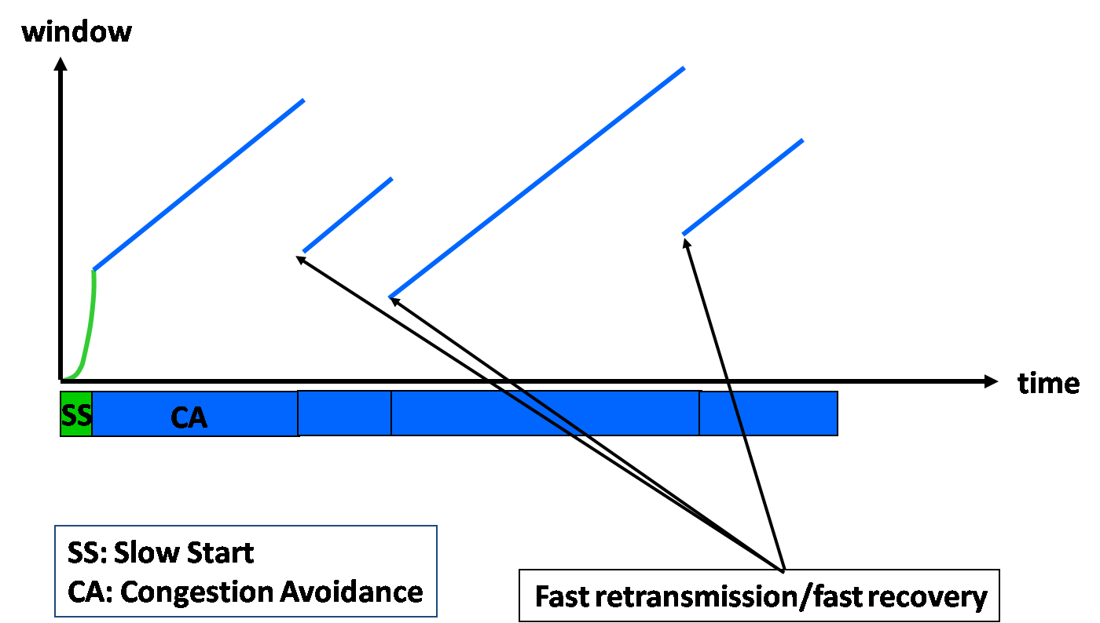
TCP Reno: TCP Tahoe +Fast Recovery
After a loss event “timer time-out”
SSthreshold = CongestionWindow / 2
Congestion window cut to 1 MSS
Enter slow-start phase
After a loss event “Duplicate ACKs”
Congestion window cut to half
SSthreshold = CongestionWindow/2
Fast re-transmit
Do not enter slow-start (called
fast recovery)
TCP Reno
Notes:
Fast Recovery. (Reno Only) In this state, TCP retransmits the missing packet that was signaled by three duplicate ACKs, and waits for an acknowledgment of the entire transmit window before returning to congestion avoidance. If there is no acknowledgment, TCP Reno experiences a timeout and enters the slow-start state. Both algorithms reduce congestion window to 1 MSS on a timeout event.
From:
In 1989, the Internet Host Requirement RFC 1122 was published. It required an Internet host that used TCP to implement the slow start and congestion avoidance algorithms, and to use Jacobson's RTO estimation algorithm with exponential backoff. Also during that time, Jacobson improved the Fast Retransmit algorithm.
By the time TCP's RTO expires, no new ack are coming in. The network has been sitting idle while TCP waited for the ack of the lost packet. So it's clear why TCP enters slow start after retransmitting because of a timeout. It has to start pumping segments into the network, just like in the beginning of a connection. Things are entirely different after a fast retransmit. Fast retransmit happens because are coming in. With good probability, duplicate acks will keep arriving as the retransmitted packet makes its way to the other side.
This realization lead to the implementation of the Fast Recovery scheme, which basically says that after a fast retransmit TCP should perform congestion avoidance but not slow start. In other words, TCP can use the information from the acks (which tells it that packets have left the network) to send new packets out.
Fast recovery kicks in when TCP does a fast retransmit. Ssthresh is set to half of the available window, but slow start is not started. Instead, cwnd is set to ssthresh and subsequently incremented by one segment for each duplicate ack that arrives. Since cwnd > ssthresh, TCP is in congestion avoidance mode. However, the normal cwnd updating doesn't happen. Cwnd is incremented only by Fast Recovery when more duplicate acks arrive. This allows TCP to inject new data into the network, even though it's in the middle of recovering from a packet loss event.
Fast recovery ends when the first non duplicate ack arrives. The old value of cwnd is restored from ssthresh. The slow recovery phase was saved!
From: http://www3.rad.com/networks/2002/tcpcong/fastrec.htm
The 4.3-Reno release of BSD UNIX (1990) is Tahoe TCP with the fast recovery modifications implemented, and its TCP stack is therefore known as Reno TCP.

Slide 40
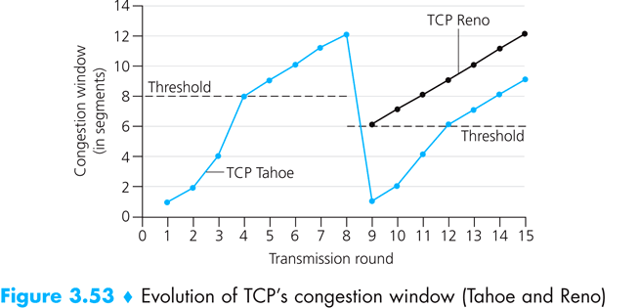
Class exercise
TCP Congestion Control
When is the SlowStart phase running? The CongestionAvoidance phase?
Difference between TCP Tahoe and TCP Reno
Notes:
Today we’d be seeing what are the primary objectives/ functions of an end-to-end transport layer protocol.
We’d also be seeing two common TCP/ IP end-to-end transport protocols that provide contrasting services: the first (UDP) provides a simple demultiplexing service and the other (TCP) provides a reliable byte stream service.

Slide 41
TCP Tahoe or Reno?
Tahoe | Reno
Threshold = CongWindow / 2 | Threshold = CongWindow / 2
CongWindow to 1 MSS on a timeout | CongWindow to 1 MSS on a timeout CongWindow to Half on 3 Dup Acks
Enter Slow Start | Enter Fast-retransmit
Sensitive to Packet loss
Small packet loss may cause significant decrease in throughput | In case of more than one packets lost in current window, TCP Reno can only re-transmit one packet. This is due to cumulative ACKs which informs about one packet in a given RTT Selective ACKs can solve the problem. Use in newer version of TCP New Reno

Slide 42
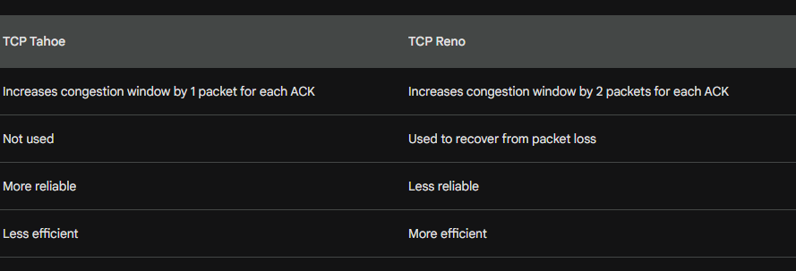
Difference
TCP Tahoe and TCP Reno are two congestion control algorithms used in the Transmission Control Protocol (TCP). TCP is a reliable transport protocol that is used to send data between two hosts on a network.
TCP Tahoe and TCP Reno both use a congestion window to control the amount of data that is sent in a single transmission. The congestion window starts at a small value and is increased slowly over time. If a packet is lost, the congestion window is decreased and the process starts over.
The main difference between TCP Tahoe and TCP Reno is how they handle packet loss. TCP Tahoe enters a slow start state when a packet is lost. In slow start, the congestion window is increased by one packet for each ACK that is received. This means that it takes a long time for the congestion window to recover from a packet loss.
TCP Reno, on the other hand, enters a fast recovery state when a packet is lost. In fast recovery, the congestion window is increased by two packets for each ACK that is received. This means that the congestion window can recover from a packet loss more quickly.
In general, TCP Reno is a more efficient congestion control algorithm than TCP Tahoe. However, TCP Tahoe is more reliable, as it is less likely to lose data due to packet loss.
Notes:
Both TCP Tahoe and TCP Reno use fast retransmit, which is a technique for recovering from packet loss. When a sender does not receive an ACK for a packet within a certain amount of time, it assumes that the packet has been lost and retransmits the packet.
TCP Reno also uses fast recovery, which is a technique for recovering from packet loss that is more efficient than slow start. When a sender receives three duplicate ACKs, it enters fast recovery mode. In fast recovery mode, the sender increases its congestion window by two packets for each ACK that is received. This allows the sender to recover from packet loss more quickly than slow start.
TCP Tahoe does not use fast recovery. When a sender receives three duplicate ACKs, it enters slow start mode. In slow start mode, the sender increases its congestion window by one packet for each ACK that is received. This means that it takes longer for the sender to recover from packet loss in slow start mode than in fast recovery mode.
In general, TCP Reno is a more efficient congestion control algorithm than TCP Tahoe. However, TCP Tahoe is more reliable, as it is less likely to lose data due to packet loss.

Slide 43
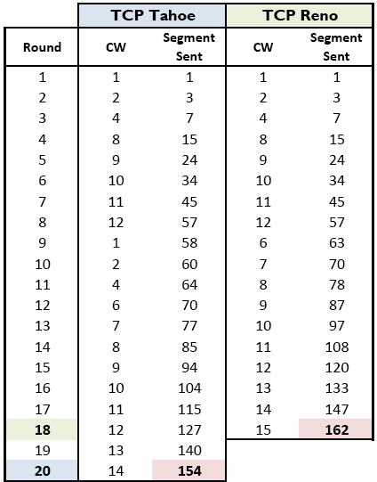
How long will it take to transfer 150 segments in TCP Tahoe? TCP Reno?
Notes:
Today we’d be seeing what are the primary objectives/ functions of an end-to-end transport layer protocol.
We’d also be seeing two common TCP/ IP end-to-end transport protocols that provide contrasting services: the first (UDP) provides a simple demultiplexing service and the other (TCP) provides a reliable byte stream service.

Slide 44
[ End of lecture ]
Images are copyrights of their respective owners
Some material in this lecture is taken from:
Dr Junaid Qadir, NUST-SEECS

